Slide 1

Dynamic Qubit Allocation and Routing for Constrained Topologies by CNOT Circuit Re-sYNthesis
${\text{Arianne} \text{Meijer}\text{ − }\text{van} \text{de} \text{Griend}}^{1}$& ${\text{Sarah} \text{Meng} \text{Li}}^{2}$
1 Department of Computer Science, University of Helsinki, Helsinki, Finland
2 Institute for Quantum Computing, University of Waterloo, Waterloo, Canada
IQC Student Seminar 2022

Slide 2
Background
TO EXECUTE quantum algorithms on real quantum hardware, we need
Quantum Compilation: Translate a program to a set of elementary quantum gates
TO REDUCE the circuit size, we need
Resource-efficient algorithms
Quantum Implementation: Map unitary operations to physical architectures
Improved quantum compiling procedures
Notes:
Connectivity constraint: Applying a multi-qubit gate on admissible qubits.

Slide 3
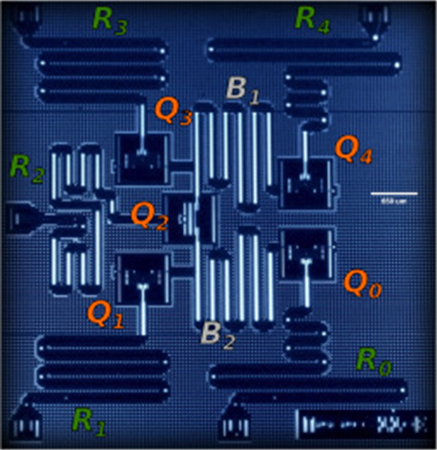
Connectivity constraints
Applying a multi-qubit gate on admissible qubits.
Not every qubit is connected to one another.
A CNOT cannot be applied to any two qubits.
The chip of a five-qubit IBM quantum computer [1].
[1] Behera, B. K., Seth, S., Das, A., & Panigrahi, P. K. (2019). Demonstration of entanglement purification and swapping protocol to design quantum repeater in IBM quantum computer. Quantum Information Processing, 18(4), 1-13.
Notes:
The problem is this: we have a quantum computer chip like I’m showing here. These squares are the qubits and as you can see, not all squares are connected together with these squiggly lines. As a result, if we want to do a 2 qubit operation, such as a CNOT, we cannot do them between arbitrary qubits.

Slide 8
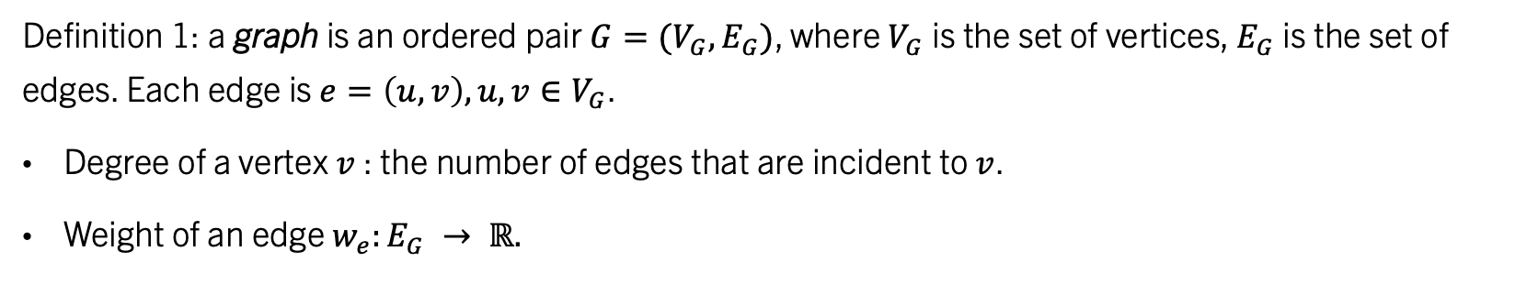
Connectivity Graph
1
4
2
3
5
Definition 1: a graph is an ordered pair $G=(V_{G}, E_{G})$, where $V_{G}$ is the set of vertices, $E_{G}$ is the set of edges. Each edge is $e=\left(u,v\right), u, v∈V_{G}$.
Degree of a vertex $v$: the number of edges that are incident to $v$.
Weight of an edge $w_{e}:E_{G} → ℝ.$
Definition 2: a connectivity graph represents the connectivity constraints of a hardware topology.
Each vertex represents a distinct physical qubits.
When two qubits are adjacent, there is an edge between the corresponding vertices.
Here we consider a simple connected graph: undirected, without self-loops.

Slide 9
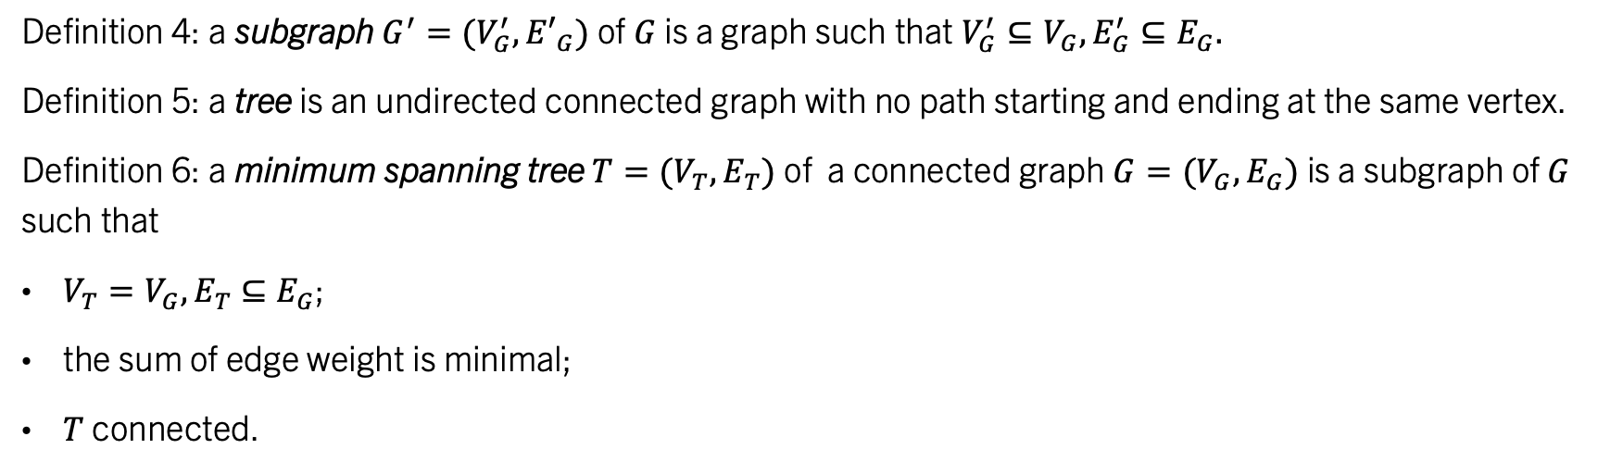
More Graph terminologies
1
4
2
Definition 3: a cut vertex is a vertex whose removal will disconnect the graph. A non-cutting vertex is a vertex that is not a cut vertex.
Vertex 2 is a cut vertex, but vertices 1, 4, 3, 5 are not.
3
5
Definition 4: a subgraph $G^{′}=(V_{G}^{′},{E′}_{G})$ of $G$ is a graph such that $V_{G}^{′}⊆V_{G},E_{G}^{′}⊆E_{G}.$
Definition 5: a tree is an undirected connected graph with no path starting and ending at the same vertex.
Definition 6: a minimum spanning tree $T=(V_{T},E_{T})$ of a connected graph $G=(V_{G},E_{G})$ is a subgraph of $G$ such that
$V_{T}=V_{G}, E_{T}$ $⊆E_{G}$;
the sum of edge weight is minimal;
$T$ connected.

Slide 10
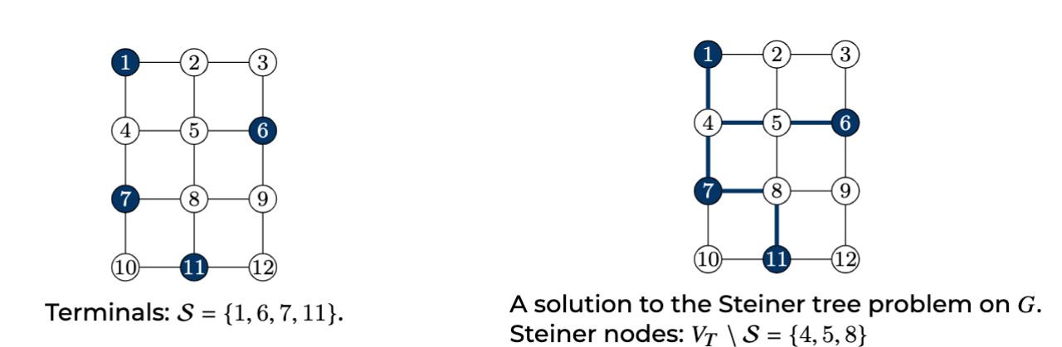
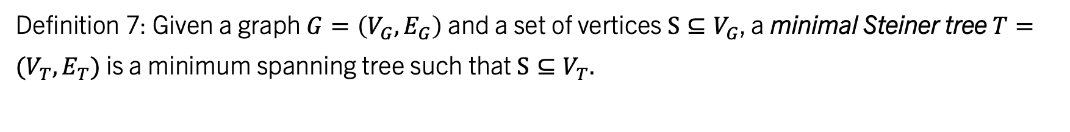
Minimum Steiner Tree
Definition 7: Given a graph $G=\left(V_{G},E_{G}\right)$ and a set of vertices $S⊆V_{G}$, a minimal Steiner tree $T=(V_{T},E_{T})$ is a minimum spanning tree such that $S⊆V_{T}.$

Slide 11
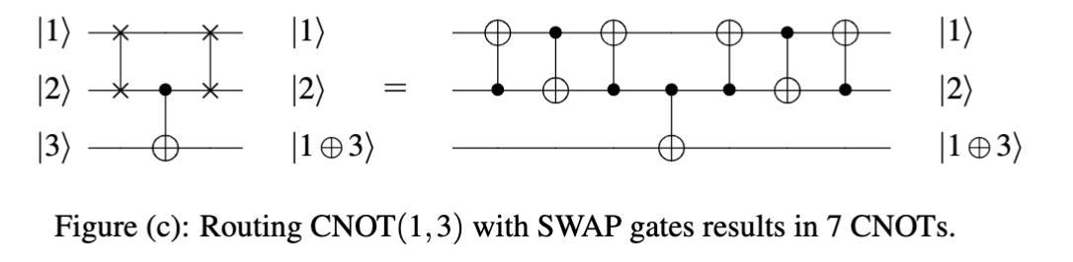
The swap-based routing
1
4
2
3
5

Slide 12

THE Circuit re-synthesis Task
CUT the quantum circuit into sequences of CNOTs between single qubit gates.
RE-SYSTHESIZE the CNOTs.
  Only generate “allowed” CNOTs
GLUE the circuit back together [5].

Slide 13
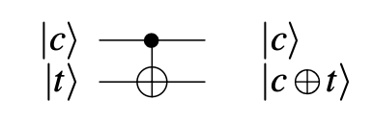
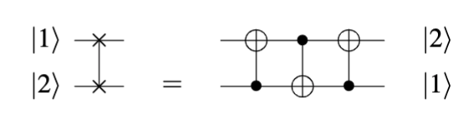
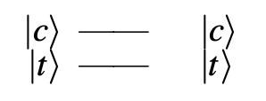
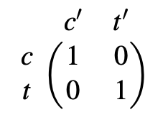
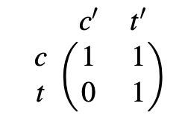
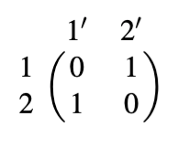
Parity Matrix for a CNOT Circuit

Slide 14
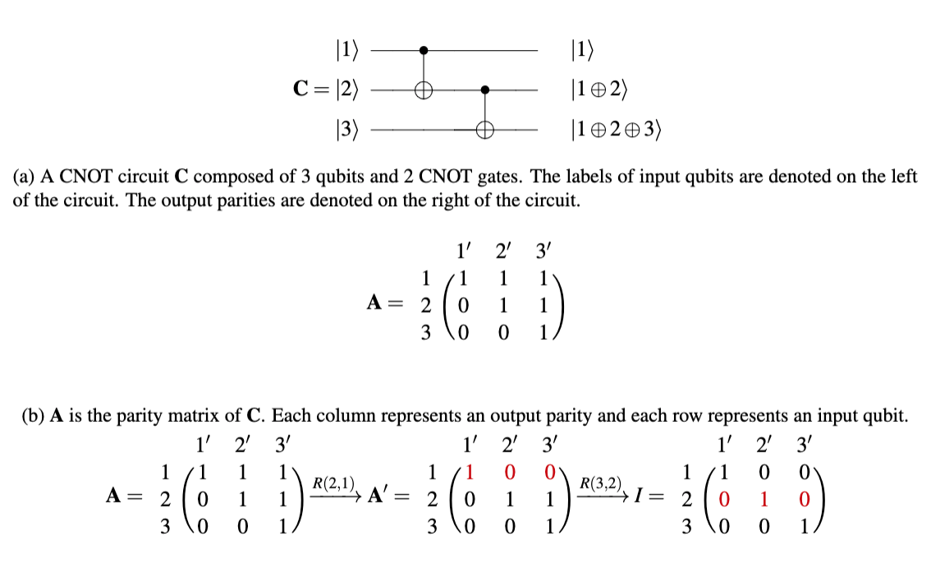

Slide 15
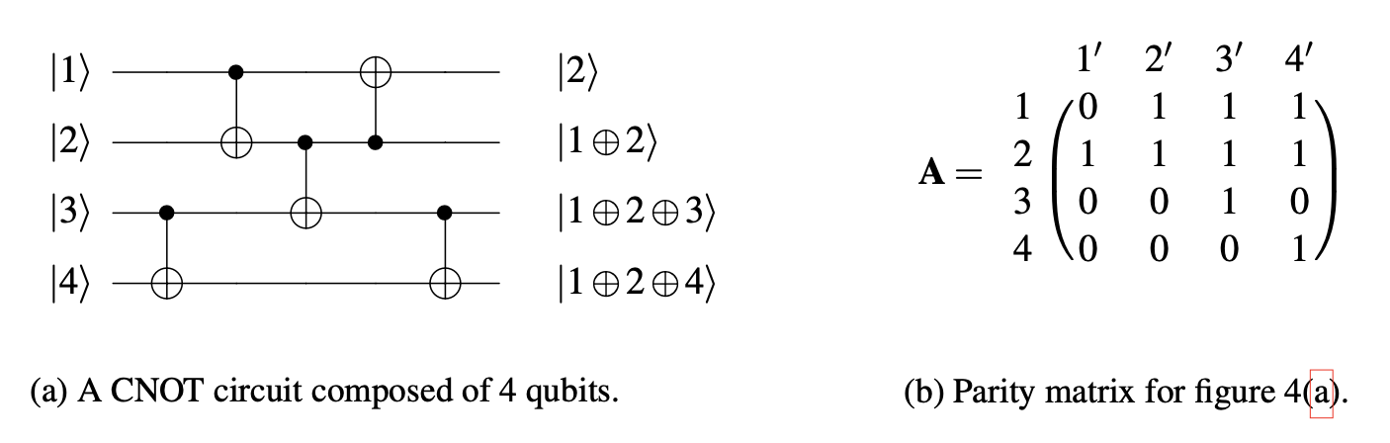
Parity Matrix Representation

Slide 16
The execution of PermRowCoL
While problem untrivial, for each iteration
Pick any row i that is non-cutting in the graph.
Pick any column j.
Reduce the column to have a 1 at row i, and 0 everywhere else.
Reduce the row to have a 1 at column j, and 0 everywhere else.
Column j is the new allocation of row i.
Remove row i and column j from the matrix
Remove vertex i from the graph.

Slide 17
PermRowCol + Reverse traversal [4]
Quantum circuit are reversable.
Route the reverse circuit to find a new initial qubit mapping.
Apply PermRowCol iteratively on original and reverse circuit.
Does not work with allocation preserving methods.

Slide 18
Let’s look at an example execution

Slide 19
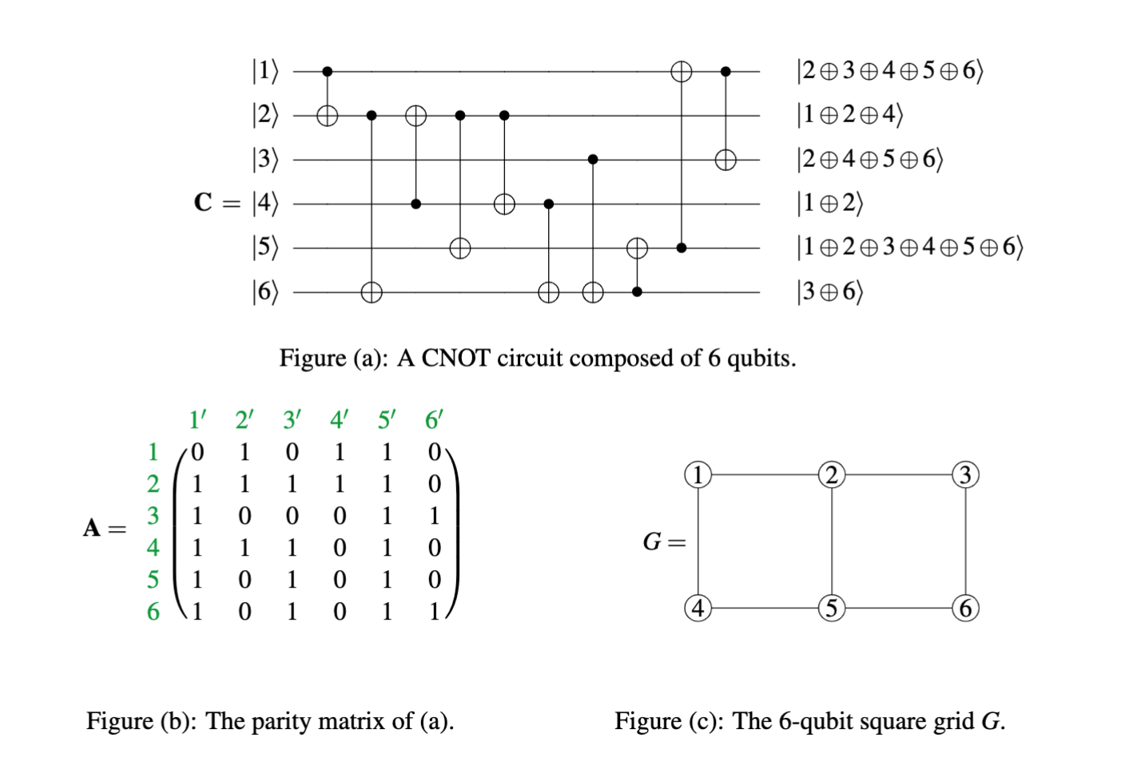

Slide 20
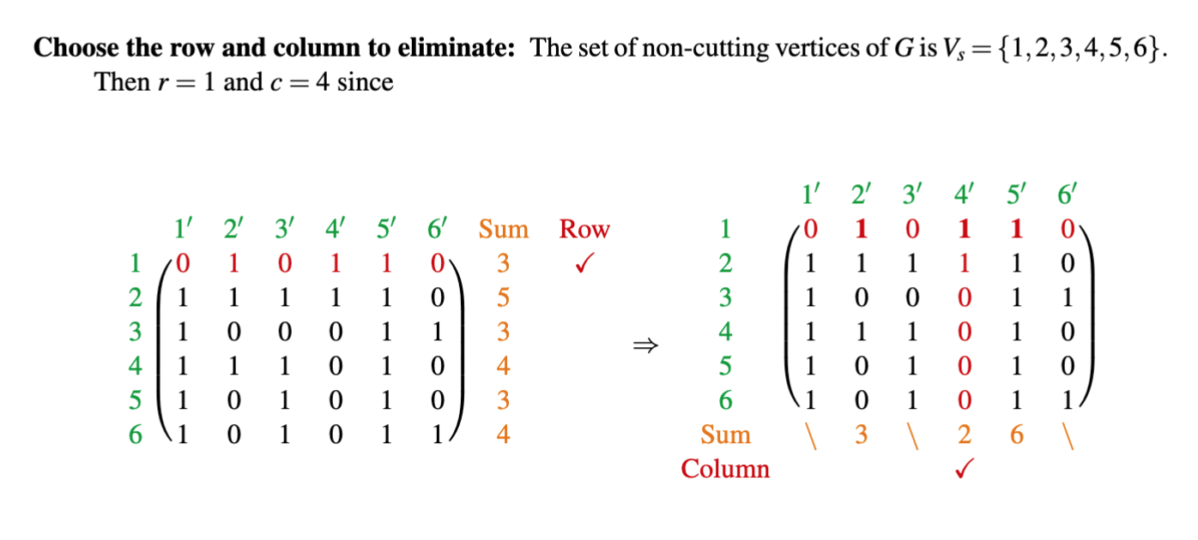

Slide 21
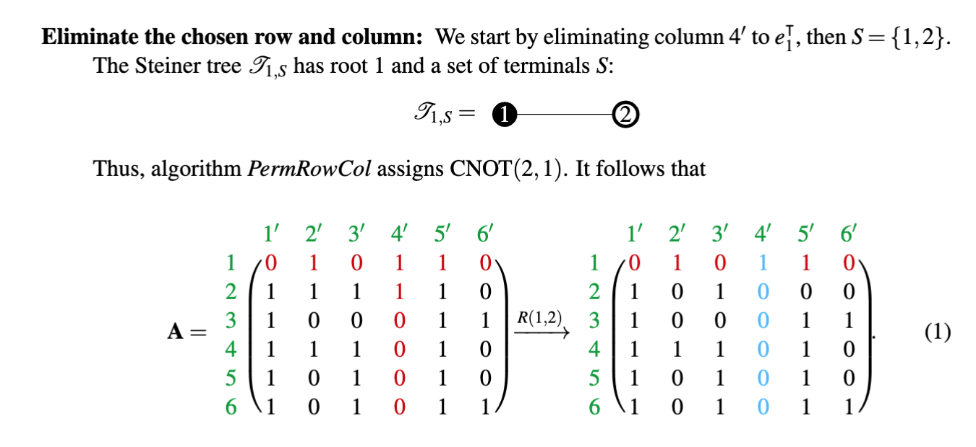

Slide 22
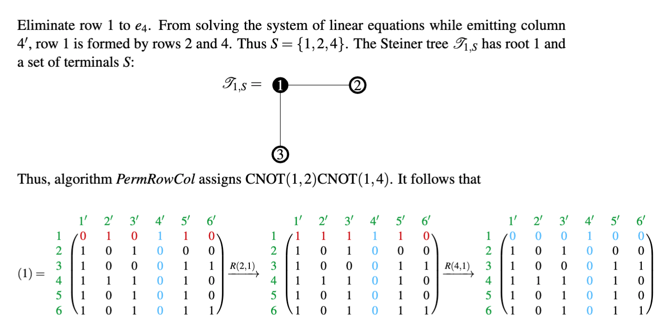

Slide 23
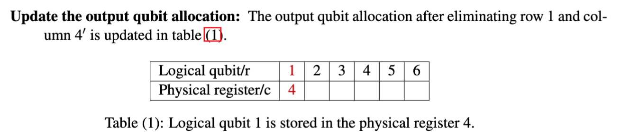

Slide 24
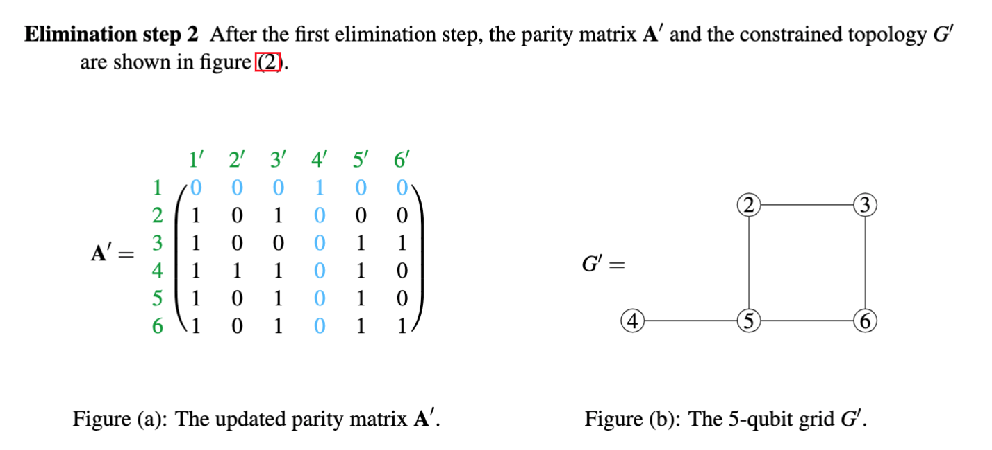
22

Slide 25
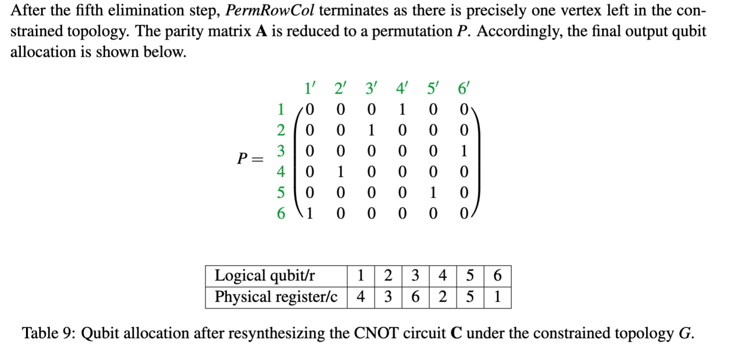
Output from PermRowCol

Slide 26
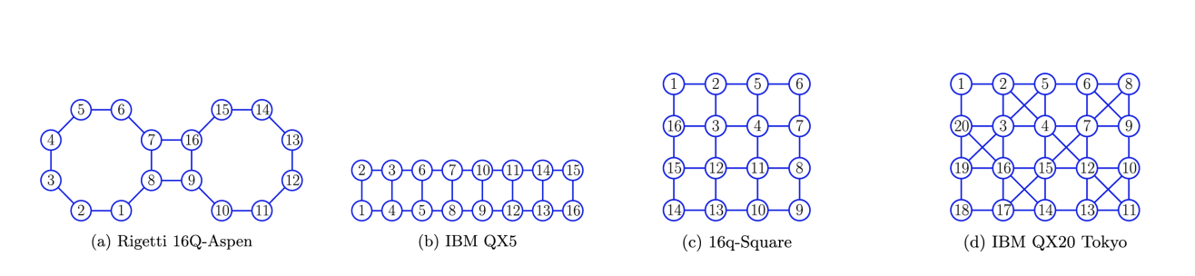
Topologies of Existing Quantum Computers for Simulations

Slide 27
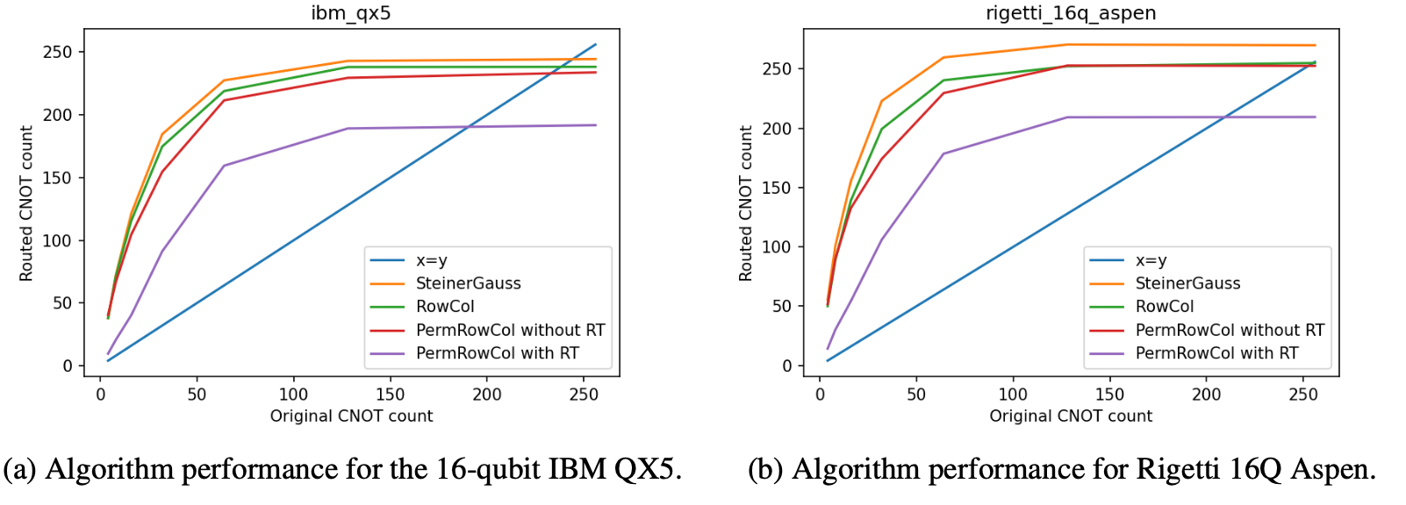
Simulation Results

Slide 28
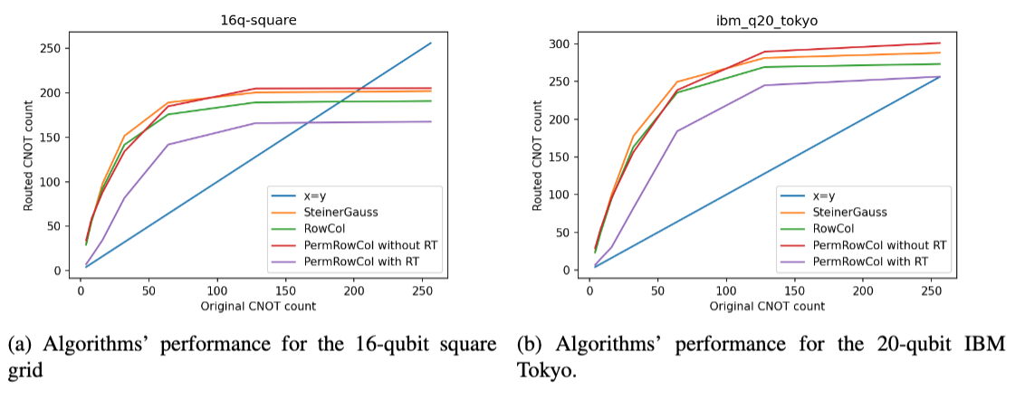
Simulation Results

Slide 29
Open Problems
Explore better heuristics for picking row/column at each reduction step.
  Determined by different topologies (i.e., average graph distance, average degree).
Improve PermRowCol by adding block-elimination method [6].
Incorporate error mitigation techniques .
  Impacted by edge weight, qubit allocation restrictions, etc.
Paper on arXiv: 2205.00724v2
Github link: shorturl.at/degqG

Slide 30
THANK YOU!

Slide 31
REFERENCE
[1] Behera, B. K., Seth, S., Das, A., & Panigrahi, P. K. (2019). Demonstration of entanglement purification and swapping protocol to design quantum repeater in IBM quantum computer. Quantum Information Processing, 18(4), 1-13.
[2a] Kissinger, A., & Meijer-van de Griend, A. (2020). CNOT circuit extraction for topologically-constrained quantum memories. Quantum Information and Computation, 20, 581-596.
[2b] Nash, B., Gheorghiu, V., & Mosca, M. (2020). Quantum circuit optimizations for NISQ architectures. Quantum Science and Technology, 5(2), 025010.
[3] Wu, B., He, X., Yang, S., Shou, L., Tian, G., Zhang, J., & Sun, X. (2019). Optimization of CNOT circuits under topological constraints. arXiv preprint arXiv:1910.14478.
[4] Li, G., Ding, Y., & Xie, Y. (2019, April). Tackling the qubit mapping problem for NISQ-era quantum devices. In Proceedings of the Twenty-Fourth International Conference on Architectural Support for Programming Languages and Operating Systems (pp. 1001-1014).
[5] Gheorghiu, V., Huang JX., Li, S. M., Mosca, M., & Mukhopadhyay, P. (2020). Reducing the CNOT count for Clifford+ T circuits on NISQ architectures. arXiv preprint arXiv:2011.12191.
[6] Patel, K. N., Markov, I. L., & Hayes, J. P. (2003). Efficient synthesis of linear reversible circuits. arXiv preprint quant-ph/0302002.

